Slide 1
Urban Expansion and Land Use Monitoring Using Custom Machine Learning Models
Group 17
ENGG 680 - Introduction to Digital Engineering
Dr. HongzhouYang
Prepared by :
Tirth, Panchal | 30240101 | tirth.panchal@ucalgary.ca
Kandarp, Rathod | 30146903 | kandarppankajbhai.ra@ucalgary.ca
Parth, Bhamani | 30240132 | parthrajeshbhai.bham@ucalgary.ca
Obehi, Edeoghon | 30217709 | obehi.edeoghon@ucalgary.ca
Chan Nyein, Aung | 30217709 | channyein.aung@ucalgary.ca
Soheil, Seifi | 30229496 | soheil.seifi@ucalgary.ca
Seyedehshima, Moradi | 30203561 | Seyedehshima.moradim@ucalgary.ca
Zohreh, Mejrisazantoosi | 30232335 | ohreh.mejrisazantoo@ucalgary.ca
2024/12/03

Slide 2
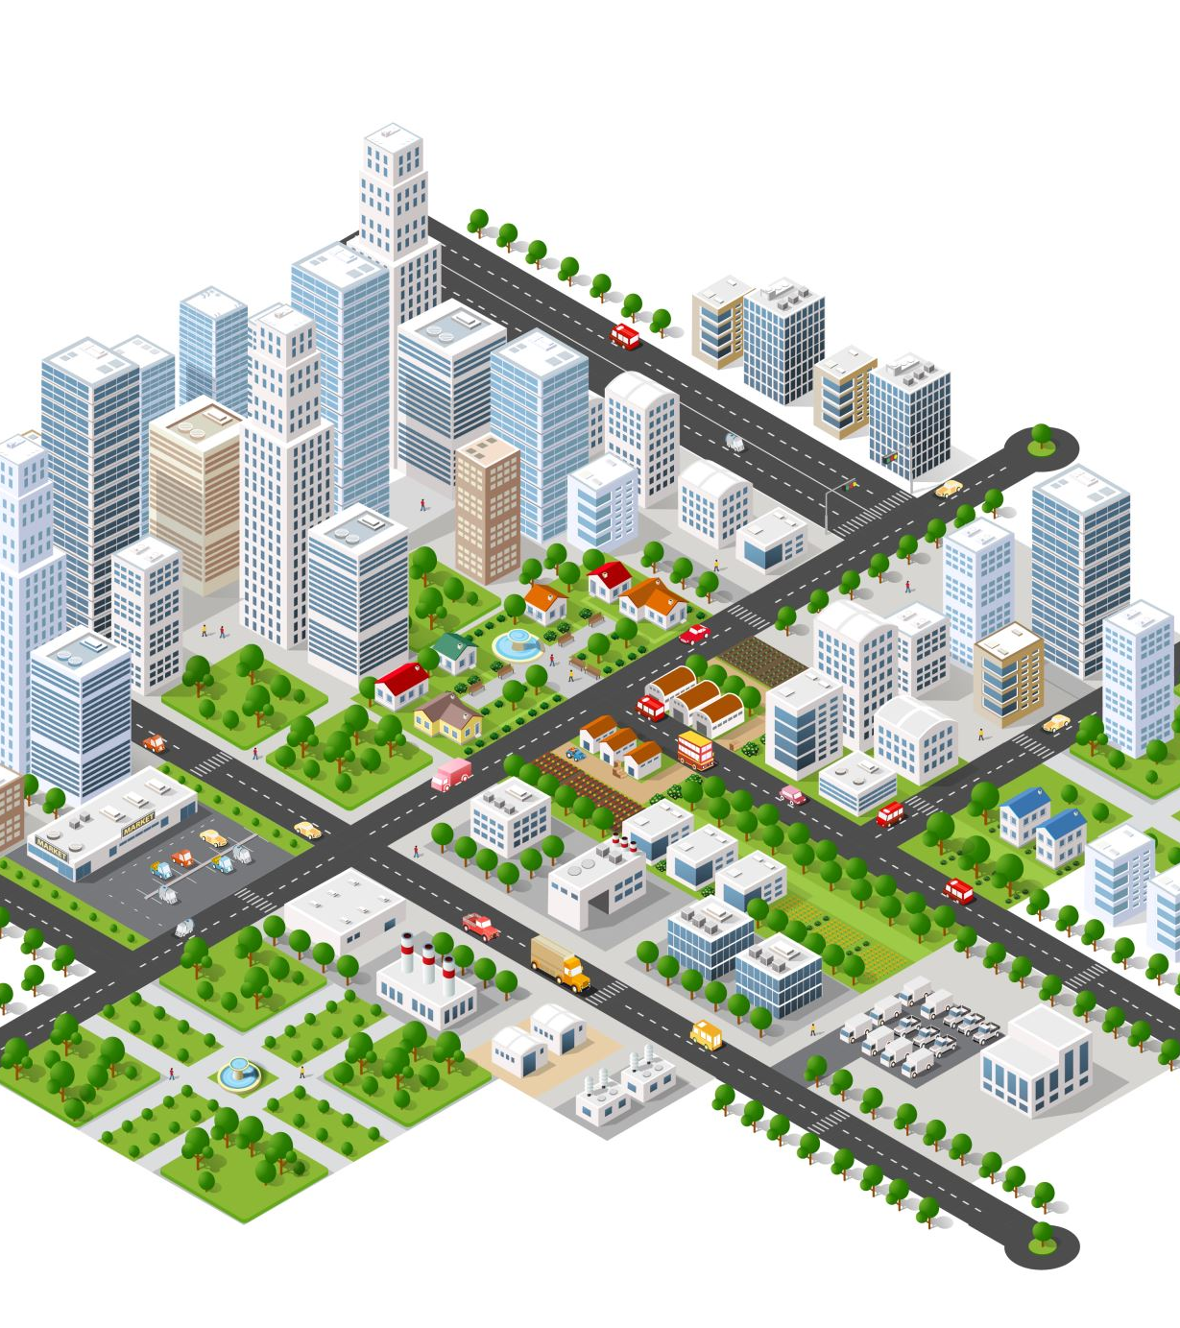
Introduction
Problem Statement: Growing urban populations and climate change are driving an increase in car accidents, highlighting the need for targeted safety and urban planning strategies.
Objective: We aim to develop a machine learning model that predicts accident-prone areas by combining historical data, weather insights, and urban growth patterns to enhance traffic safety..
Significance: The model provides city planners with data-driven insights to strategically improve road safety, optimize traffic flow, and ultimately enhance urban living conditions.

Slide 3

Existing Solutions and Gaps
Current Approaches:
Traditional Statistical Models:
Linear Regression: Predicts traffic incidents from continuous variables like traffic volume and weather conditions.
Logistic Regression: Calculates the probability of traffic incidents using categorical and continuous variables.
Time Series Analysis: Identifies trends and seasonal patterns in traffic incident data.
Advanced Machine Learning Models:
Neural Networks: Capture complex, non-linear relationships in traffic data.
Support Vector Machines: Effective for classification and regression.
Random Forests: Combine decision trees to enhance prediction robustness.

Slide 4

Existing Solutions and Gaps (Cont.)
Gaps Identified
Lack of Urban Growth Integration:
Urban Development: Current models often overlook how ongoing city projects reshape traffic patterns.
Population Dynamics: Existing approaches inadequately model migration's impact on transportation infrastructure.
Limited Predictive Accuracy in Dynamic Conditions:
Real-Time Data: Limited integration of sensors and IoT data hinders predictive accuracy.
Weather Impact: Insufficient modeling of weather conditions on traffic patterns.

Slide 5
Methodology Overview
Steps:
Data Sources:
Data Collection and Cleaning.
Traffic Incidents (City of Calgary).
Machine Learning Model Development.
Historical Weather Data (Government of Canada).
Model Validation and Tuning.
Results Analysis and Insights.

Slide 6
Current State Of Model and Result
 | True Negatives | False Positives | False Negatives | True Positives
Cluster0 | 114 | 179 | 13 | 182
Cluster1 | 195 | 138 | 47 | 108
Cluster2 | 115 | 116 | 37 | 220
Cluster3 | 62 | 170 | 15 | 241
Cluster4 | 126 | 118 | 39 | 205
Cluster5 | 2 | 203 | 2 | 281
 | 2928 | 1390 | 11% | 89%

Slide 7
Traffic Incidents Data Cleaning
Feature is important for analysis
Finding Missing values
Feature is less important/ irrelevance for analysis
Fill
Drop
Manual Corrections
Imputation techniques
🕛
🕕
Time Intervals for 1 Day
1-14 days
Notes:
Overview: Processed historical traffic data (2017–2024) for analysis.
Extracted important features
Handled missing values
Introduced time periods
Included historical days columns
Date, Time Periods, Clusters, and Incident Types. And make them binary in order to be understandable for machine learning model
by carefully analyzing patterns and applying appropriate techniques.
(Morning, Lunch, Evening, Midnight) for better temporal insights.
for segments because of patterns
to enhance predictive capabilities. And the model can learn patterns and trends

Slide 8
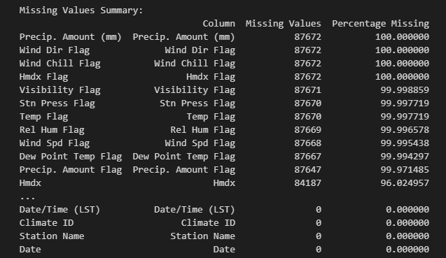
Weather Data Cleaning
Missing Value
Fill
Strategies
Drop
Mean
Mode
Temperature, Humidity, Wind Speed, etc.
Wind Direction
Features are important for analysis
Features are 100% missing or irrelevance

Slide 9
Merging Data
Matched and Merged Incident and weather datasets
Date
Time Period
Merging Traffic Incidents and Weather datasets
Notes:
We must use overlapping date data for both weather and traffic incidents.
(e.g., recent months for high relevance).
Resulting merged data ensures comprehensive coverage of traffic and weather features.

Slide 10

Model Training

Slide 11
Model Training
Features
Weather Data
Historical Car Accidents
Model
Random Forest
K-Nearest Neighbors
Label
Binary Prediction of Car Accident in Each Time Segment
Gradient Boosting Machines
Neural Networks

Slide 12
Initial Model Training
Random Forest
Train Score = 1
Test Score= 0.32

Slide 13
Data Collection
Iterative Model Training Process
High
Data Cleaning
Gap between test score and train score
Low
Data Modeling
Data Validation
Validation analyzing Result
Not Good
Good
Model with High accuracy and logical

Slide 14
Training Data with Different Models
SVM
Train Score = 1
Test Score = 0.62
Random Forest
Train Score = 1
Test Score = 0.64
XGBoost
CatBoost
Train Score = 1
Test Score = 0.69
Train Score = 1
Test Score = 0.71

Slide 15
Conclusion
Summary:
Combined traffic and weather data to predict urban traffic accidents.
The process highlights the potential of machine learning for solving real-world challenges.
Applications:
Enhance traffic management and road safety.
Inform urban planning and infrastructure improvements.
Support the design of safer, smarter vehicles.

Slide 16
References
[1] “Station Results - Historical Data - Climate - Environment and Climate Change Canada,” [Online]. Available: https://climate.weather.gc.ca/historical_data/search_historic_data_e.html. [Accessed 11 Oct. 2024].
[2] “Building Permits | Open Calgary,” [Online]. Available: https://data.calgary.ca/Business-and-Economic-Activity/Building-Permits/c2es-76ed/about_data. [Accessed 11 Oct. 2024].
[3] “Street Centreline,” [Online]. Available: https://data.calgary.ca/Transportation-Transit/Street-Centreline/4dx8-rtm5/about_data. [Accessed 11 Oct. 2024].
[4] “Traffic Incidents | Open Calgary,” [Online]. Available: https://data.calgary.ca/Transportation-Transit/Traffic-Incidents/35ra-9556/about_data. [Accessed 11 Oct. 2024].
[5] F. S. A. P. B. H. A. Shahla, “Analysis of Transit Safety at Signalized Intersections in Toronto, Ontario, Canada,” Transportation Research Record: Journal of the Transportation Research Board, vol. 2102, pp. 108-114, 2009.
[6] W. G. Y. L. C. K. T.-H. T. a. X. B. Y. H. Zhao, “Prediction of Traffic Incident Duration Using Clustering-Based Ensemble Learning Method,” Journal of Transportation Engineering, Part A: Systems, vol. 148, July 2022.
[7] B. W. a. A. H. J. Evans, “Evolution and Future of Urban Road Incident Detection Algorithms,” Journal of Transportation Engineering, Part A: Systems, vol. 146, June 2020.

Slide 17

Q & A

